Slide 1


Slide 2


Slide 3
History :
Acase of male patient 20 years old presented with sudden pain ,lacrimation ,redness of his Rt. already non-seeing eye after blunt trauma 6 hours duration .

Slide 4
Past history :
There is past history of previous RD surgery 7 years ago and previous squint surgery 6 years ago outside sohag university hospital.

Slide 5
Examination :
Eye : Irritable
Lacrimation
Conjunctive : ciliary injection
Cornea : ulcer
Anterior chamber : total hyphema
Iris: cannot be seen
Pupil: cannot be seen
Intraocular pressure :digitally soft

Slide 6
Sclera :scleral buckle
Fundus :cannot be seen

Slide 7
:Investigation
Ultrasonography : high vitreous ecchos mostly
vitreous hemorrhage and total RD.
A-Scan and comparison axial lengh of both eyes: atrophia bulbi of affected eye
Complete blood picture : normal
Prothrombin time and concentration : normal

Slide 8
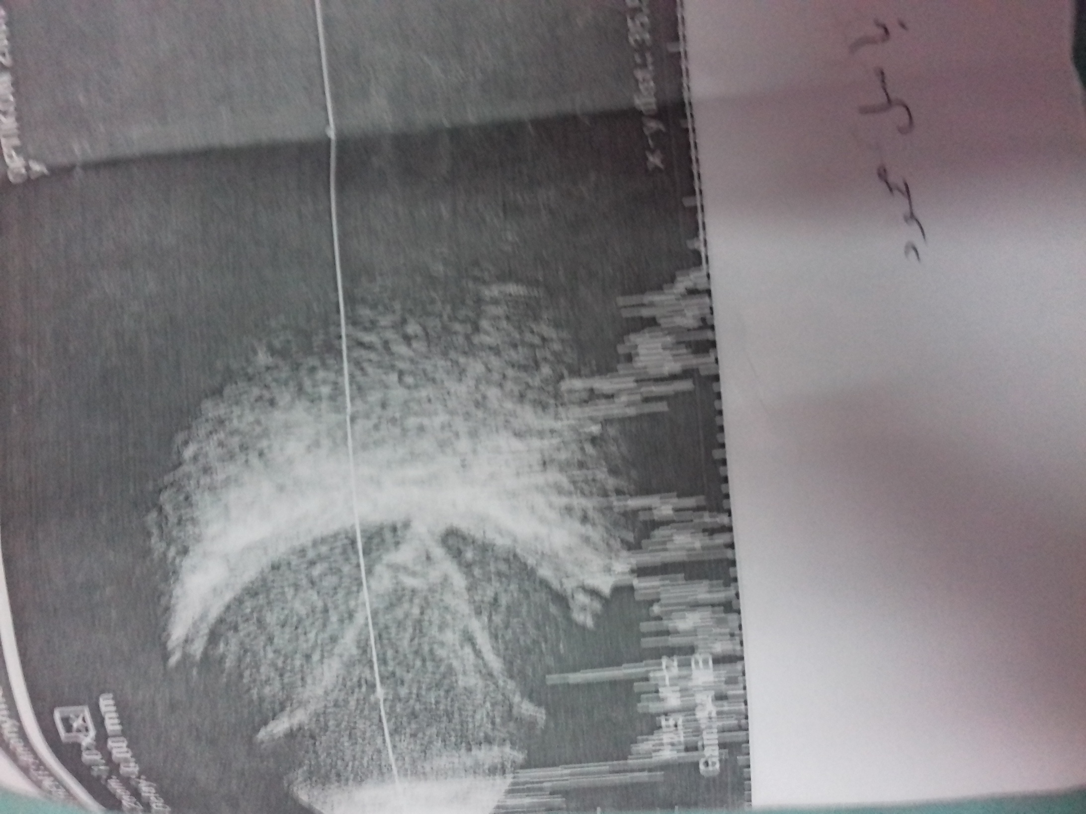

Slide 9
Diagnosis :
A case of hyphema ,vitreous hemorrhage, RD in pathological (atrophic eye).

Slide 10
Management
Aim at prevention of secondary hemorrhage and prevention of elevation of IOP and quieting the eye .

Slide 11
Lines of treatment:
1- topical antibiotic
2-topical steroid
3-cycloplegico
4-haemostatic drugs (dicynone and kapron )

Slide 12


